Slide 1
Cloud Programming and Software Environments
Features of Cloud & Grid
Parallel & Distributed programming paradigms
Map-Reduce
HDFS
Programming support of Google Cloud, Google File System, Big Table
Amazon AWS & Azure.
Case Studies: OpenStack & Aneka

Slide 2
FEATURES OF CLOUD & GRID
Features of Cloud and Grid Platforms:
Cloud Capabilities and Platform Features
Traditional Features Common to Grids and Clouds
Data Features and Databases
Programming and Runtime Support
Note: Entries in these tables are source references for anyone who wants to program the cloud efficiently.

Slide 3
CLOUD CAPABILITIES AND PLATFORM FEATURES
Commercial clouds need broad capabilities (summarized in Table 6.1).
These capabilities offer cost-effective utility computing with the elasticity to scale up and down in power.
Also, commercial clouds offer a growing number of additional capabilities commonly termed “Platform as a Service” (PaaS).
Azure - current platform features - Azure Table, queues, blobs, Database SQL, and web and Worker roles.
Amazon – offers Infrastructure as a Service (IaaS), platform features - SimpleDB (similar to Azure Table), queues, notification, monitoring, content delivery network, relational database, and MapReduce (Hadoop).
Google App Engine (GAE) - offers a powerful web application development environment.

Slide 4
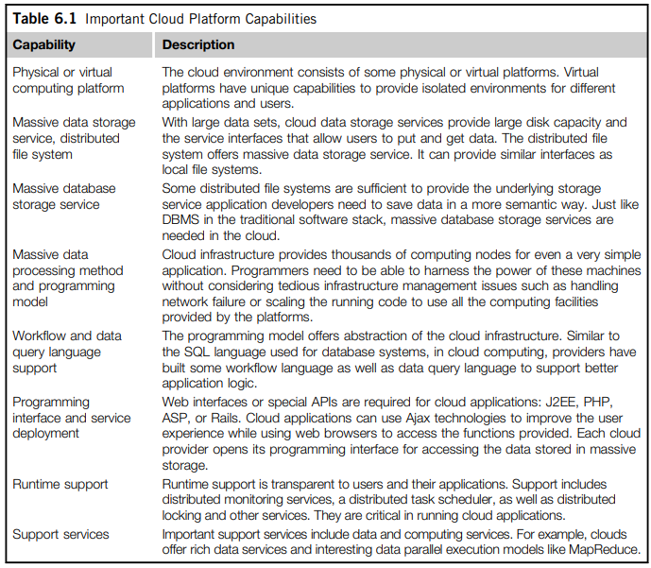

Slide 5
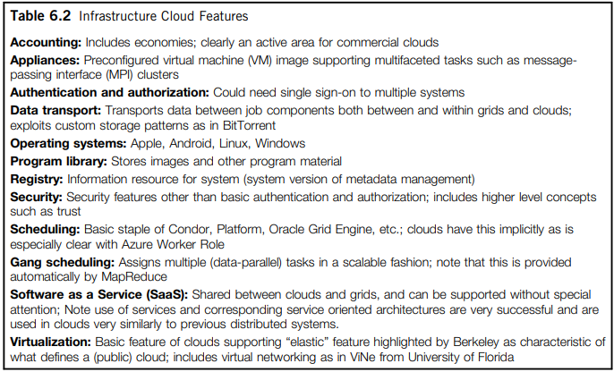
Table 6.2 lists some low-level infrastructure features.

Slide 6
TRADITIONAL FEATURES COMMON TO GRIDS AND CLOUDS
Workflow:
  Workflow links multiple cloud and noncloud services in real applications on demand.
  Ex: Commercial systems - Pipeline Pilot, AVS (dated), and LIMS environments and Trident (from Microsoft)
  AVS – Address Verification Service
  LIMS – Laboratory Information Management System
Data Transport:
  Cost (in time and money) of data transport in commercial clouds - a difficulty in using clouds.
  high-bandwidth links - between clouds and TeraGrid.

Slide 7
Security, Privacy, and Availability:
• Virtual clustering - to achieve dynamic resource provisioning with minimum overhead cost.
• Stable and persistent data storage with fast queries - for information retrieval.
• Special APIs - for authenticating users and sending e-mail using commercial accounts.
• Cloud resources are accessed with security protocols such as HTTPS and SSL.
• Fine-grained access control - is desired to protect data integrity and deter intruders or hackers.
• Shared data sets are protected from malicious alteration, deletion, or copyright violations.
• Features are included for availability enhancement and disaster recovery with life migration of VMs.
• Use a reputation system to protect data centers. This system only authorizes trusted clients and stops pirates.

Slide 8
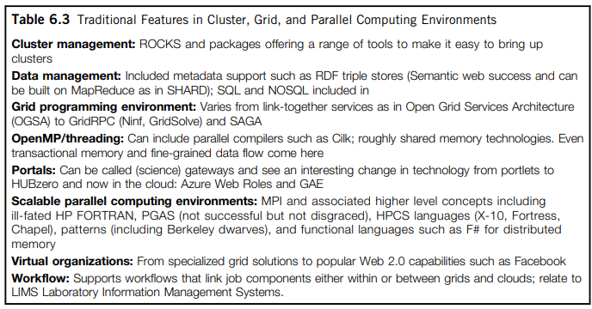
Table 6.3 lists traditional programming environments for parallel and distributed systems that need to be supported in Cloud environments.
They can be supplied as part of system (Cloud Platform) or user environment.

Slide 9
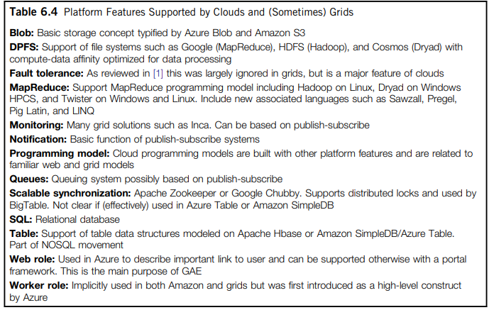
Table 6.4 presents features emphasized by clouds and by some grids.
Note: Some of the features - recently offered – will discuss in last section.

Slide 10
DATA FEATURES AND DATABASES
Program Library:
Many efforts have been made to design a VM image library to manage images used in academic and commercial clouds.
Blobs and Drives:
Basic storage concept in clouds is – blobs (Azure) & S3 (Amazon).
This concept is similar to shared file systems – Lustre in TeraGrid.
Note:
  The cloud storage is intrinsically fault-tolerant while
  TeraGrid needs backup storage.
  DPFS ( Distributed Parallel File System):
  DPFS file systems - precisely designed for efficient execution of data-intensive applications.
  supports file systems such as Google File System (MapReduce), HDFS (Hadoop), and Cosmos (Dryad) with compute-data affinity optimized for data processing.

Slide 11
SQL and Relational Databases:
Both Amazon and Azure clouds offer relational databases
FutureGrid - a new private cloud computing model for the Observational Medical Outcomes Partnership (OMOP) for patient-related medical data which uses Oracle and SAS, and Hadoop for scaling to many different analysis methods.
On Azure and Amazon, the database is installed on a separate VM independent from your job. This implements “SQL as a Service.”
Table and NOSQL Nonrelational Databases:
A substantial number of important developments have occurred regarding simplified database structures—termed “NOSQL” - typically emphasizing distribution and scalability.
Present in the three major clouds:
  BigTable - Google, SimpleDB - Amazon, and Azure Table - Azure.
  Queuing Services:
  Both Amazon & Azure offer similar scalable, robust queuing services - to communicate between the components of an application.
  Messages are short (less than 8 KB) & have a Representational State Transfer (REST) service interface with “deliver at least once” semantics.
  They are controlled by timeouts for posting the length of time allowed for a client to process.

Slide 12
PROGRAMMING AND RUNTIME SUPPORT
Worker and Web Roles:
The roles introduced by Azure provide nontrivial functionality, while preserving the better support in a nonvirtualized environment.
Worker roles are basic schedulable processes and are automatically launched.
Web roles provide an interesting approach to portals.
GAE is largely aimed at web applications, whereas science gateways are successful in TeraGrid.
MapReduce:
There has been substantial interest in “data parallel” languages - largely aimed at loosely coupled computations - which execute over different data samples.
The language and runtime generate and provide efficient execution of “many task” problems that are well known as successful grid applications.
However, MapReduce, summarized in Table 6.5, has several advantages over traditional implementations for many task problems, as it supports dynamic execution, strong fault tolerance, and an easy-to-use high-level interface.

Slide 13
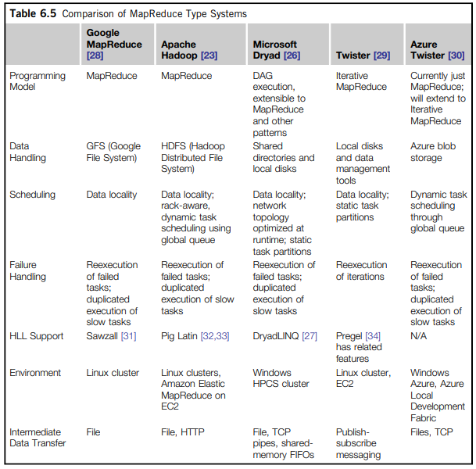
Major open source/commercial MapReduce implementations - Hadoop & Dryad - execution possible with or without VMs.
Hadoop is currently offered by Amazon, and we expect Dryad to be available on Azure.

Slide 14
Cloud Programming Models:
Both GAE & Manjrasoft Aneka environments represent programming models;
both are applied to clouds.
Iterative MapReduce - an interesting programming model that offers portability between cloud, HPC and cluster environments.
SaaS:
Services are used in a similar fashion in commercial clouds and most modern distributed systems.
We desire a SaaS environment - that provides many useful tools to develop cloud applications over large data sets.
Also, protection features that may help us to achieve scalability, security, privacy, and availability are required.

